Slide 1
BUSINESS INTELLIGENCE
ANALYSIS
Global Store | Power BI Executive Presentation
DATA → INSIGHT → ACTION
Prepared by: [Dumisani Chinyanga] • [CSE-AIML/ 24AIT-NTPP-2A]

Slide 2
1. Introduction & Objective
BUSINESS CONTEXT
OBJECTIVE OF ANALYSIS
Global Store uses sales, product, customer and profit data to understand performance and guide decisions.
Evaluate business performance, identify strengths and weaknesses, and recommend practical improvements using Power BI.
ANALYSIS AREAS
Sales
Products
Customers
Profit
Revenue & trends
Top / low performers
Buying patterns
Category profitability

Slide 3
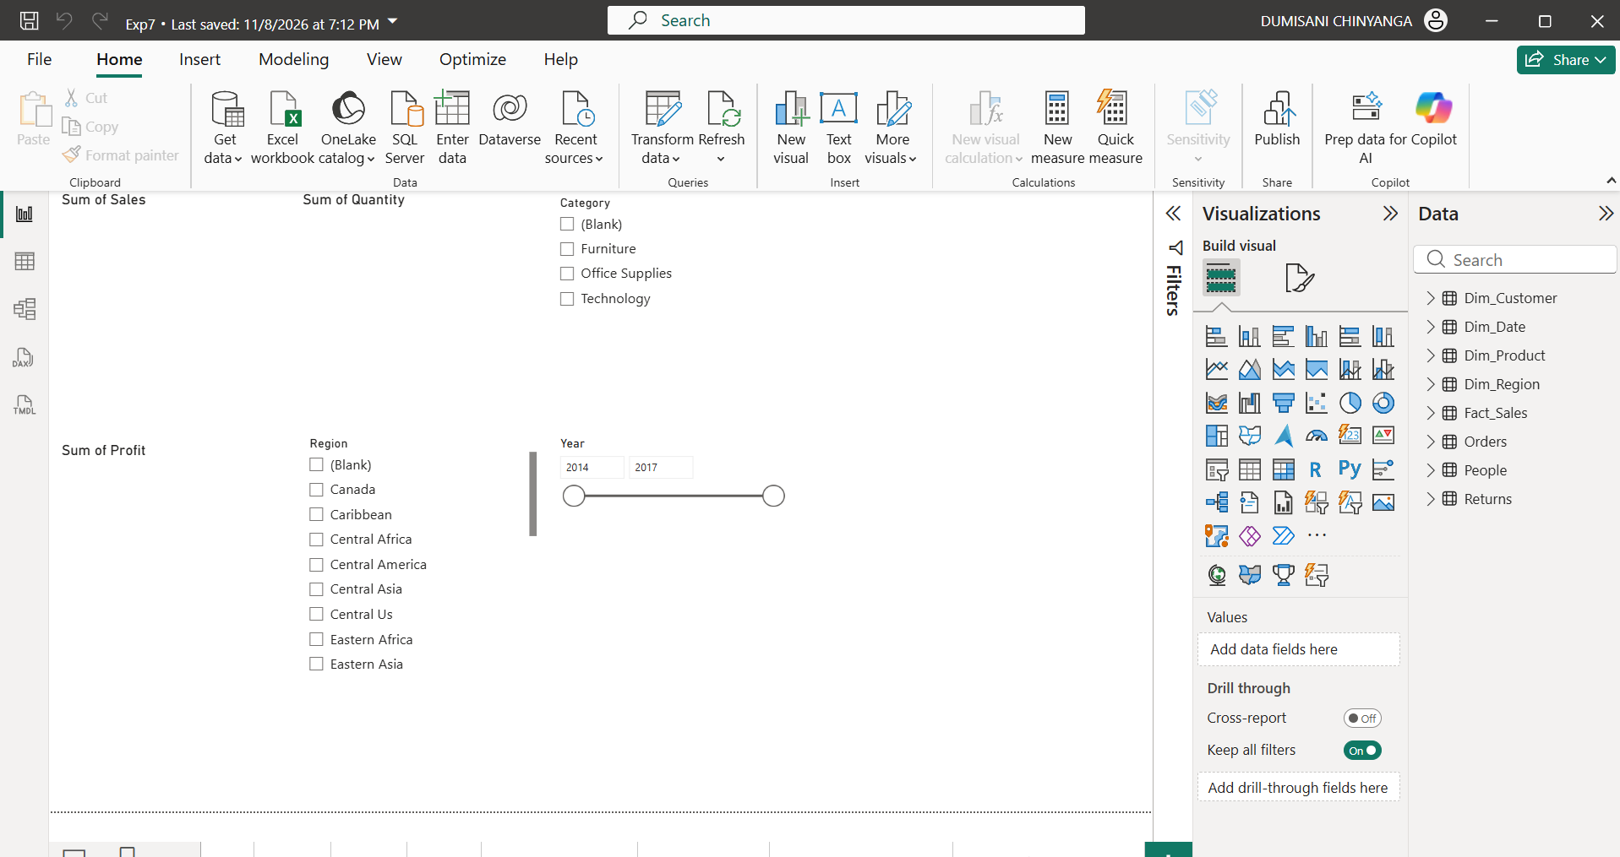
2. Dashboard Overview
SALES OVERVIEW
Total revenue, monthly sales and trends.
PRODUCT PERFORMANCE
Top products and low-selling items.
CUSTOMER & PROFIT
Customer patterns and profitability.

Slide 4
3. Key Findings
TOTAL SALES
TOTAL PROFIT
TOP CATEGORY
TOP PRODUCT
[₹ 12.64M]
[₹ 1.47M]
[Office Supplies]
[Eaton Cards ]
Revenue for selected period
Profit generated
Highest sales contribution
Best-selling product
FINDING 1 — SALES & PRODUCTS
FINDING 2 — CUSTOMERS & PROFIT
Sales increased/decreased by 70% over the period. The leading product/category was Office Supplies.]
[Customer segment Eaton Cards contributed the most revenue. Category Office Supplies had the highest profit margin.]

Slide 5
4. Business Strengths & Issues
BUSINESS STRENGTHS
BUSINESS WEAKNESSES / ISSUES
• Strong sales contribution from [Office Supplies/Eaton Cards]
• Profitable customer segments: [Paper]
• Clear visibility of KPIs through interactive dashboards
• Low sales in [SanDisk Memo Slips]
• Profit margin pressure in [Technology]
• Sales fluctuations during [9 months]

Slide 6
5. Recommendations & Expected Impact
BUSINESS AREA | RECOMMENDATION | EXPECTED BENEFIT
Products | Promote [SanDisk Memo Slips] using targeted offers. | Improve product sales.
Profit | Prioritize [Eaton Cards] in campaigns. | Improve overall profitability.
Customers | Create loyalty offers for [Eaton Cards]. | Increase repeat purchases.
Planning | Use monthly trends to plan stock and promotions. | Reduce stock issues and improve planning.

Slide 7
6. Conclusion
Power BI turns Global Store data into actionable business insight.
• Dashboards provide visibility into sales, products, customers and profit.
• The analysis highlights business strengths and areas requiring attention.
• Recommendations should be prioritized and monitored using measurable KPIs.
THANK YOU

